Slide 1
UAH Monopoly
CS 321-02 Spring 2019

Slide 2
Introduction
Members, Responsibilities, and Workflow
Project Overview
Project Details
UML diagram
Use Cases
Design Patterns
Gameplay demo
Conclusion

Slide 3
Project overview
Team Members and Roles
Sean Mitchell - Backend
Megan Haskins - Graphics
Ansley Solomon – XML/Database
Workflow
Weekly meetings in person to discuss progress
Communication via GroupMe application
Code stored and shared on Github
Project Statistics
N .java files
N images
N commits to Github

Slide 4
The Project – Summary
Set player names, number of rounds for game
Create board
Player turns – roll dice, move token, end turn
Buy, sell, trade properties
Draw chance, community chest cards
Go to jail

Slide 5
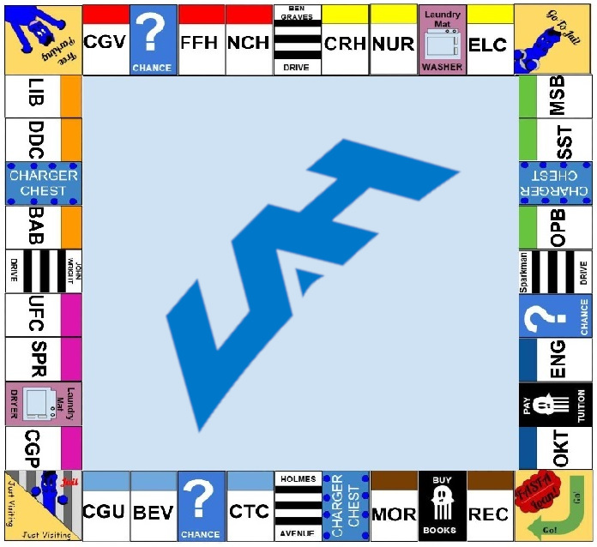
The Project – Megan Haskins
GUI
Event driven program
Error pop-ups
Images
Classes I wrote: View1

Slide 6
The Project – Sean Mitchell
Wrote backend code for player and tile classes
Provided an interface between GUI and XML
Javadoc and inline documentation
Classes I wrote
Tile_Adapter, Player, Board, Dice_Roller, tile subclasses

Slide 7
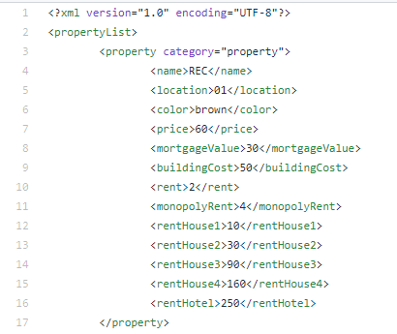
The Project – Ansley Solomon
Gathered information for properties
Wrote Chance and Community Chance cards
Wrote XML files
Wrote XML parser
Added Javadoc comments
Classes I Wrote: Card, Decks, Property, Crosswalk, Utilities, PropertyList

Slide 8
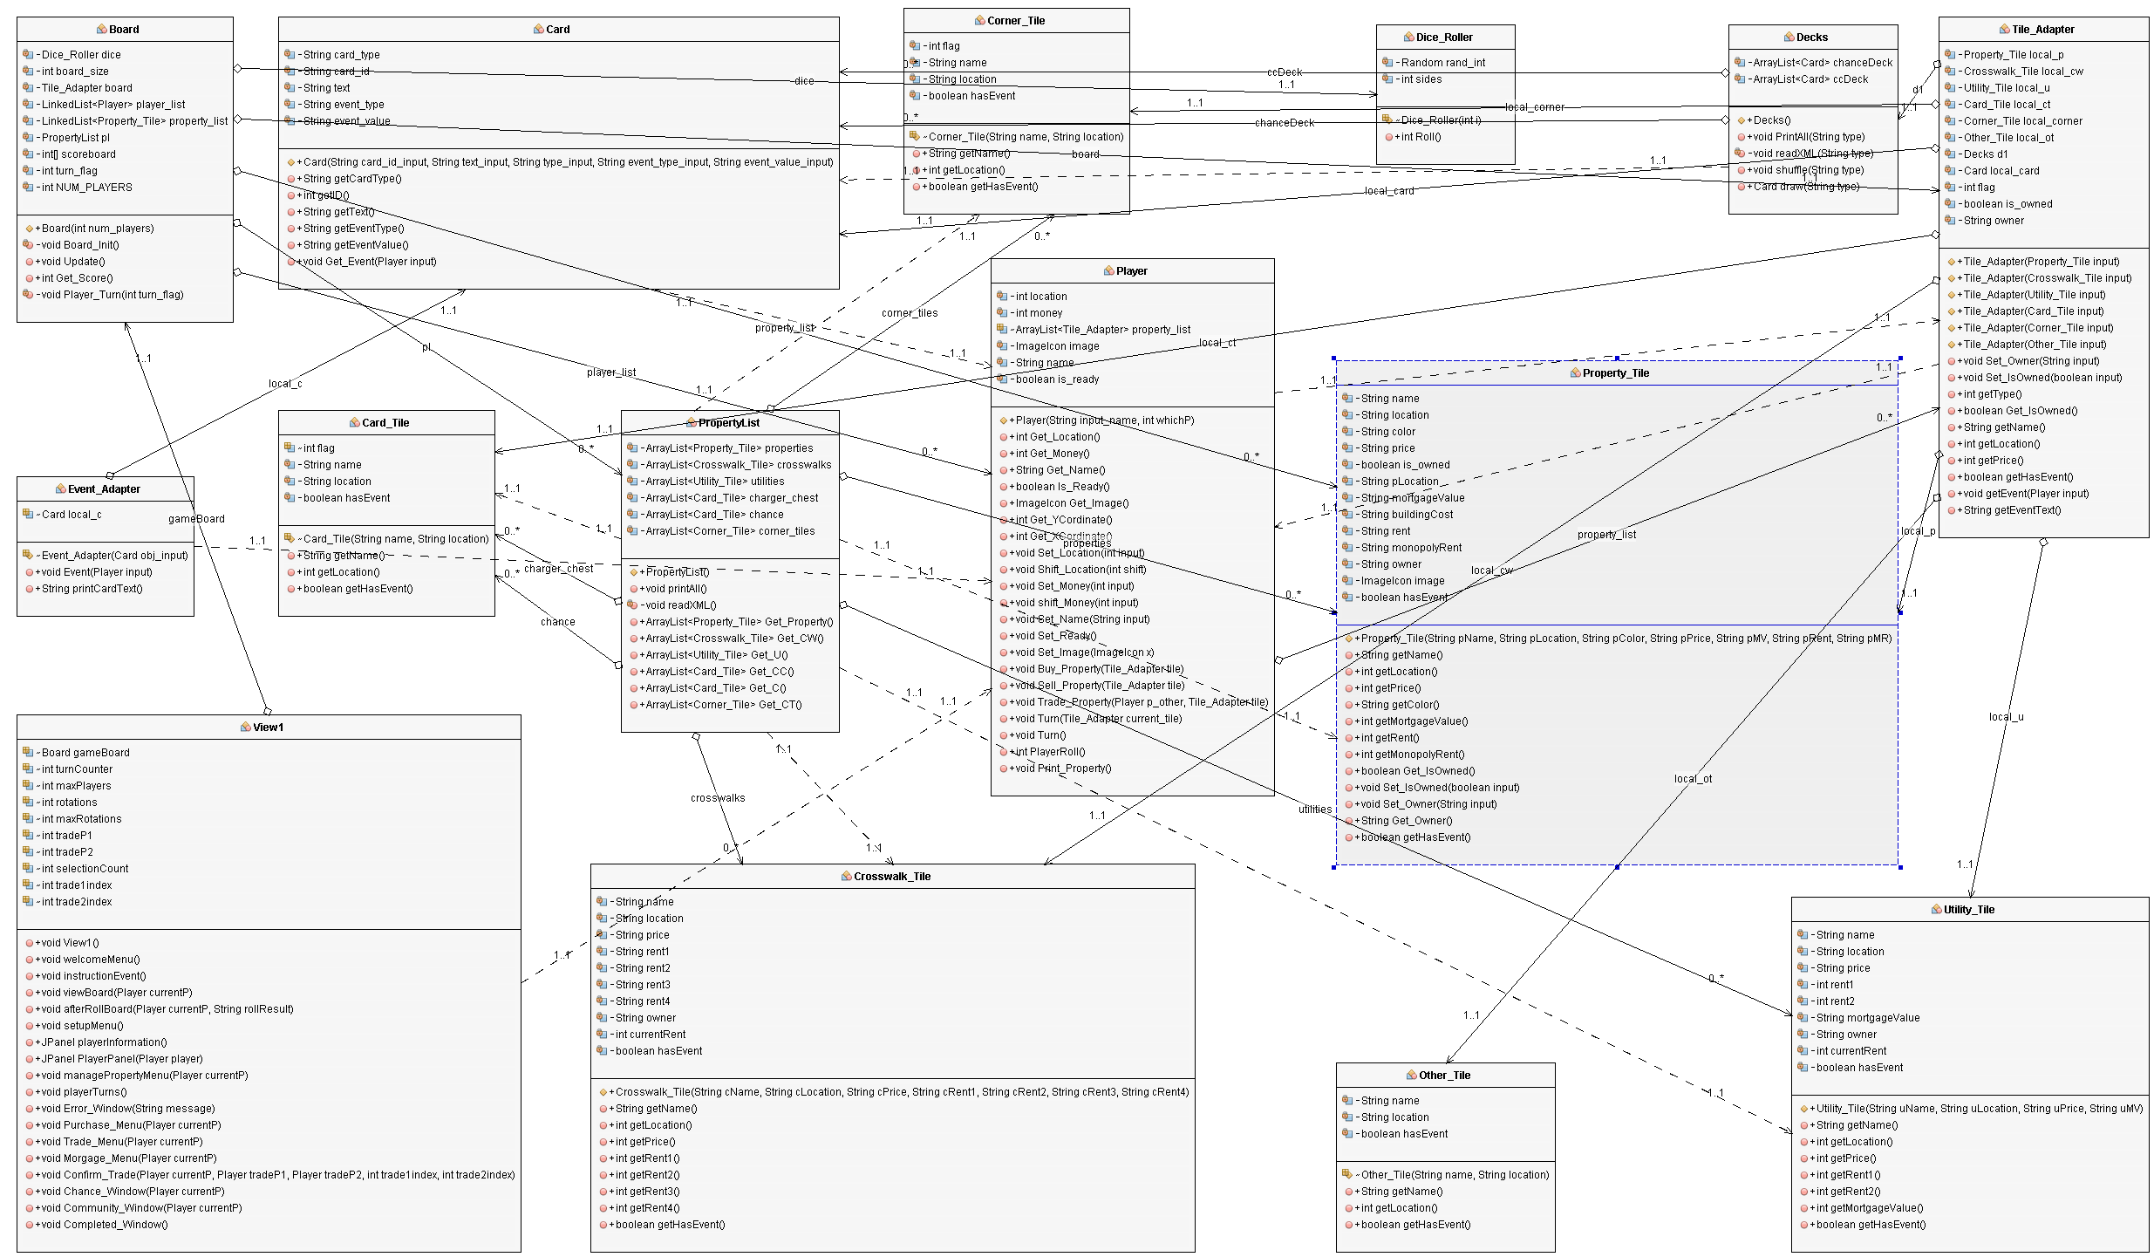
UML Diagram

Slide 9
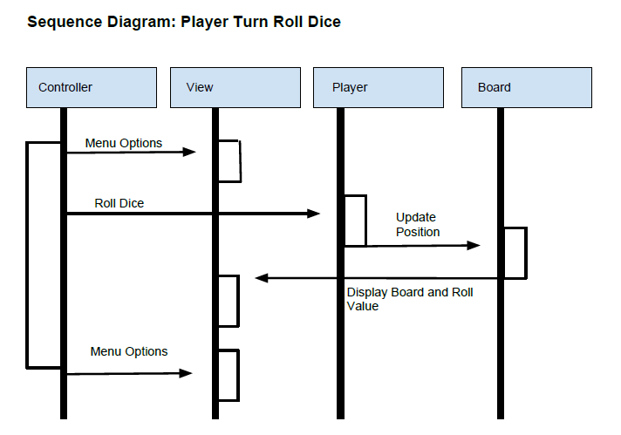
Use Case 1: Roll Dice
User clicks “roll Dice” button
Random number is created
Number is displayed to the screen
Player’s token moves that number of spaces on the board

Slide 10
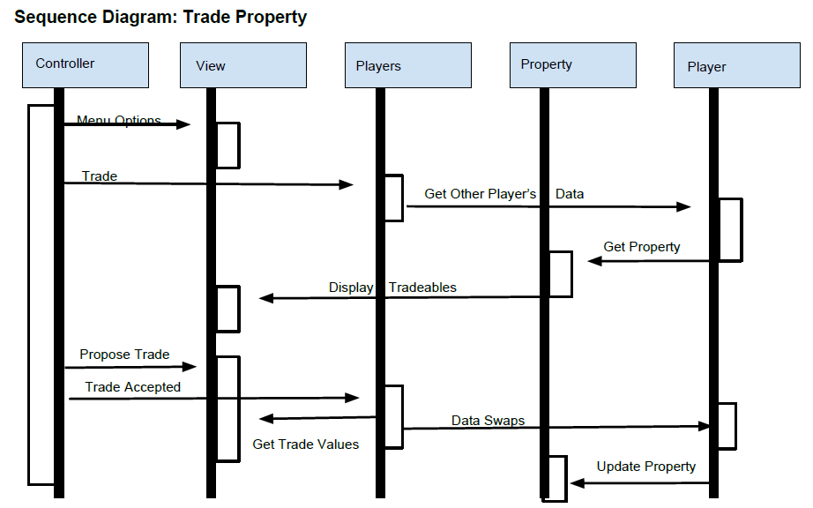
Use Case 2: Trade Properties
Current player clicks on “Manage Properties”
Current player uses drop-down menus to suggest a trade
Second player accepts trade
Players’ properties are swapped

Slide 11
Use Case 3: Draw Chance Card
Player lands on Chance
Chance card is drawn
Text appears on screen
Event is triggered
Player either gains or loses money or moves on the board

Slide 12
Design patterns
Passive MVC
Adapter

Slide 13
Demo
Real gameplay!

Slide 14
Conclusion
Final summary
UAH themed monopoly
Tiles and cards generated from XML on startup
Dynamic events for when a player lands on a tile or draws a card
Graphical interface for players to interact with
Questions?
Our GitHub
https://github.com/SeanMitchell1994/CS321_SP2019
Pull the .zip file under the v1.0 release if you want to play the game

